Slide 1
Education for the future
Morten Hjorth-Jensen^{1,2}
Anders Malthe-Sørenssen¹
¹Department of Physics, University of Oslo
²Department of Physics and Astronomy, Michigan State University, USA

Slide 2
Present and future education
Research-based education, from undergraduate studies to a PhD: The Computational Physics group at the University of Oslo as an example
Future challenges and directions
Takeaway message:
Excellent research depends on excellent education – and vice versa!

Slide 3
The role of computations, from education to society
Computations are central to our understanding of nature and to technological advances
UiO’s strength in computational science (education and research) has the potential to make UiO a top European University
Examples
Nanotech and Materials: quantum physical systems in nanotechnology; characteristics of new materials; semi-conductor devices and quantum computers
The smallest particles in nature: subatomic physics at its smallest length scale
And the largest: simulating galaxies and the evolution of the universe
Life science: cancer treatment and how the brain works
Geosciences: climate change and weather, natural disasters
Finance: assessing risk in the insurance and financial industry
and many many more

Slide 4
Modeling and computations as a way to enhance algorithmic thinking
Algorithm : A set of instructions to solve a problem
Algorithmic thinking applies to all disciplines. It
Enhances instruction-based teaching
Introduces research-based teaching from day one
Triggers further insights in scientific problems
Emphasizes validation and verification of scientific results, and integrates science ethics in a natural way
Ensures good working practices from day one!

Slide 5
What does computing mean?
Computing means solving scientific problems using computers.
Computing competence is about:
Derivation, verification, and implementation of algorithms
Understanding what can go wrong with algorithms
Overview of important, known algorithms
Understanding how algorithms are used to solve complicated problems
Reproducible science and ethics
Algorithmic thinking for deeper insights into science
All these elements help students mature scientifically

Slide 6
Computing and research-based education
A computational approach allows us to introduce research concepts and engage students in research from day one
What should the education contain?
Theory+experiment+simulation is the norm in research and industry
Modeling of real, complex systems with no simple answers
Insight and understanding of fundamental principles and laws
Visualization, presentation, discussion, interpretation, and critical analysis of results
Development of sound ethical attitude to own and other’s work
Enhanced reasoning about the scientific method
Indiviually tailored education for students to realize their full potentials
This is what we do in the Computational Physics group at UiO!

Slide 7
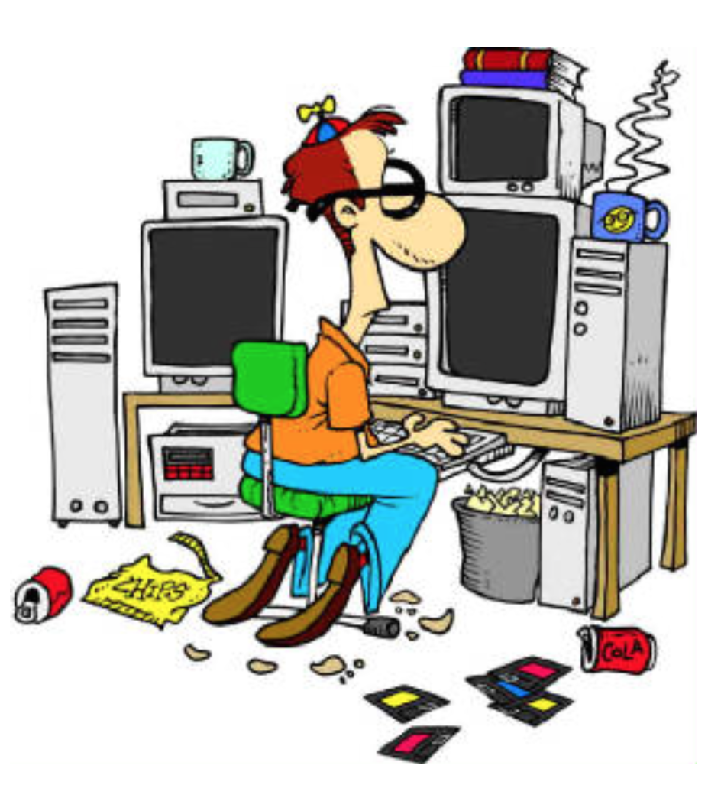
Computational Physics group – our visions
Students pose and solve problems that combine physical insights with mathematical tools and computational skills
Essential for multi-disciplinary educational and research programs

Slide 8


Slide 9


Slide 10
A social and scientific learning environment
Goal: Students should realize their full potential and discover their creative powers!
Students come with different dreams, ambitions, and topics – we tailor an education
Foster students that are better than ourselves!
Emphasis on learning and new insights
Students and teacher help each other
Non-competitive and generous environment

Slide 11
We develop a social and scientific learning environment
Target BSc, MSc, and PhD students
Project-oriented work – students develop their own ideas
Office space with desktops for every student
Common room for scientific and social activities
Collaborative thesis projects

Slide 12
Features of the Computational Physics group
Students contribute to the Computing in Science Education project (UiO educational prize 2011)
Our students develop educational tools to improve student insights
A group of PhD students now develop new textbooks for Computational Life Science
2005-2015: >60 MSc students and 60% have continued with PhD studies
Many students do not want to leave the group after finishing their studies

Slide 13
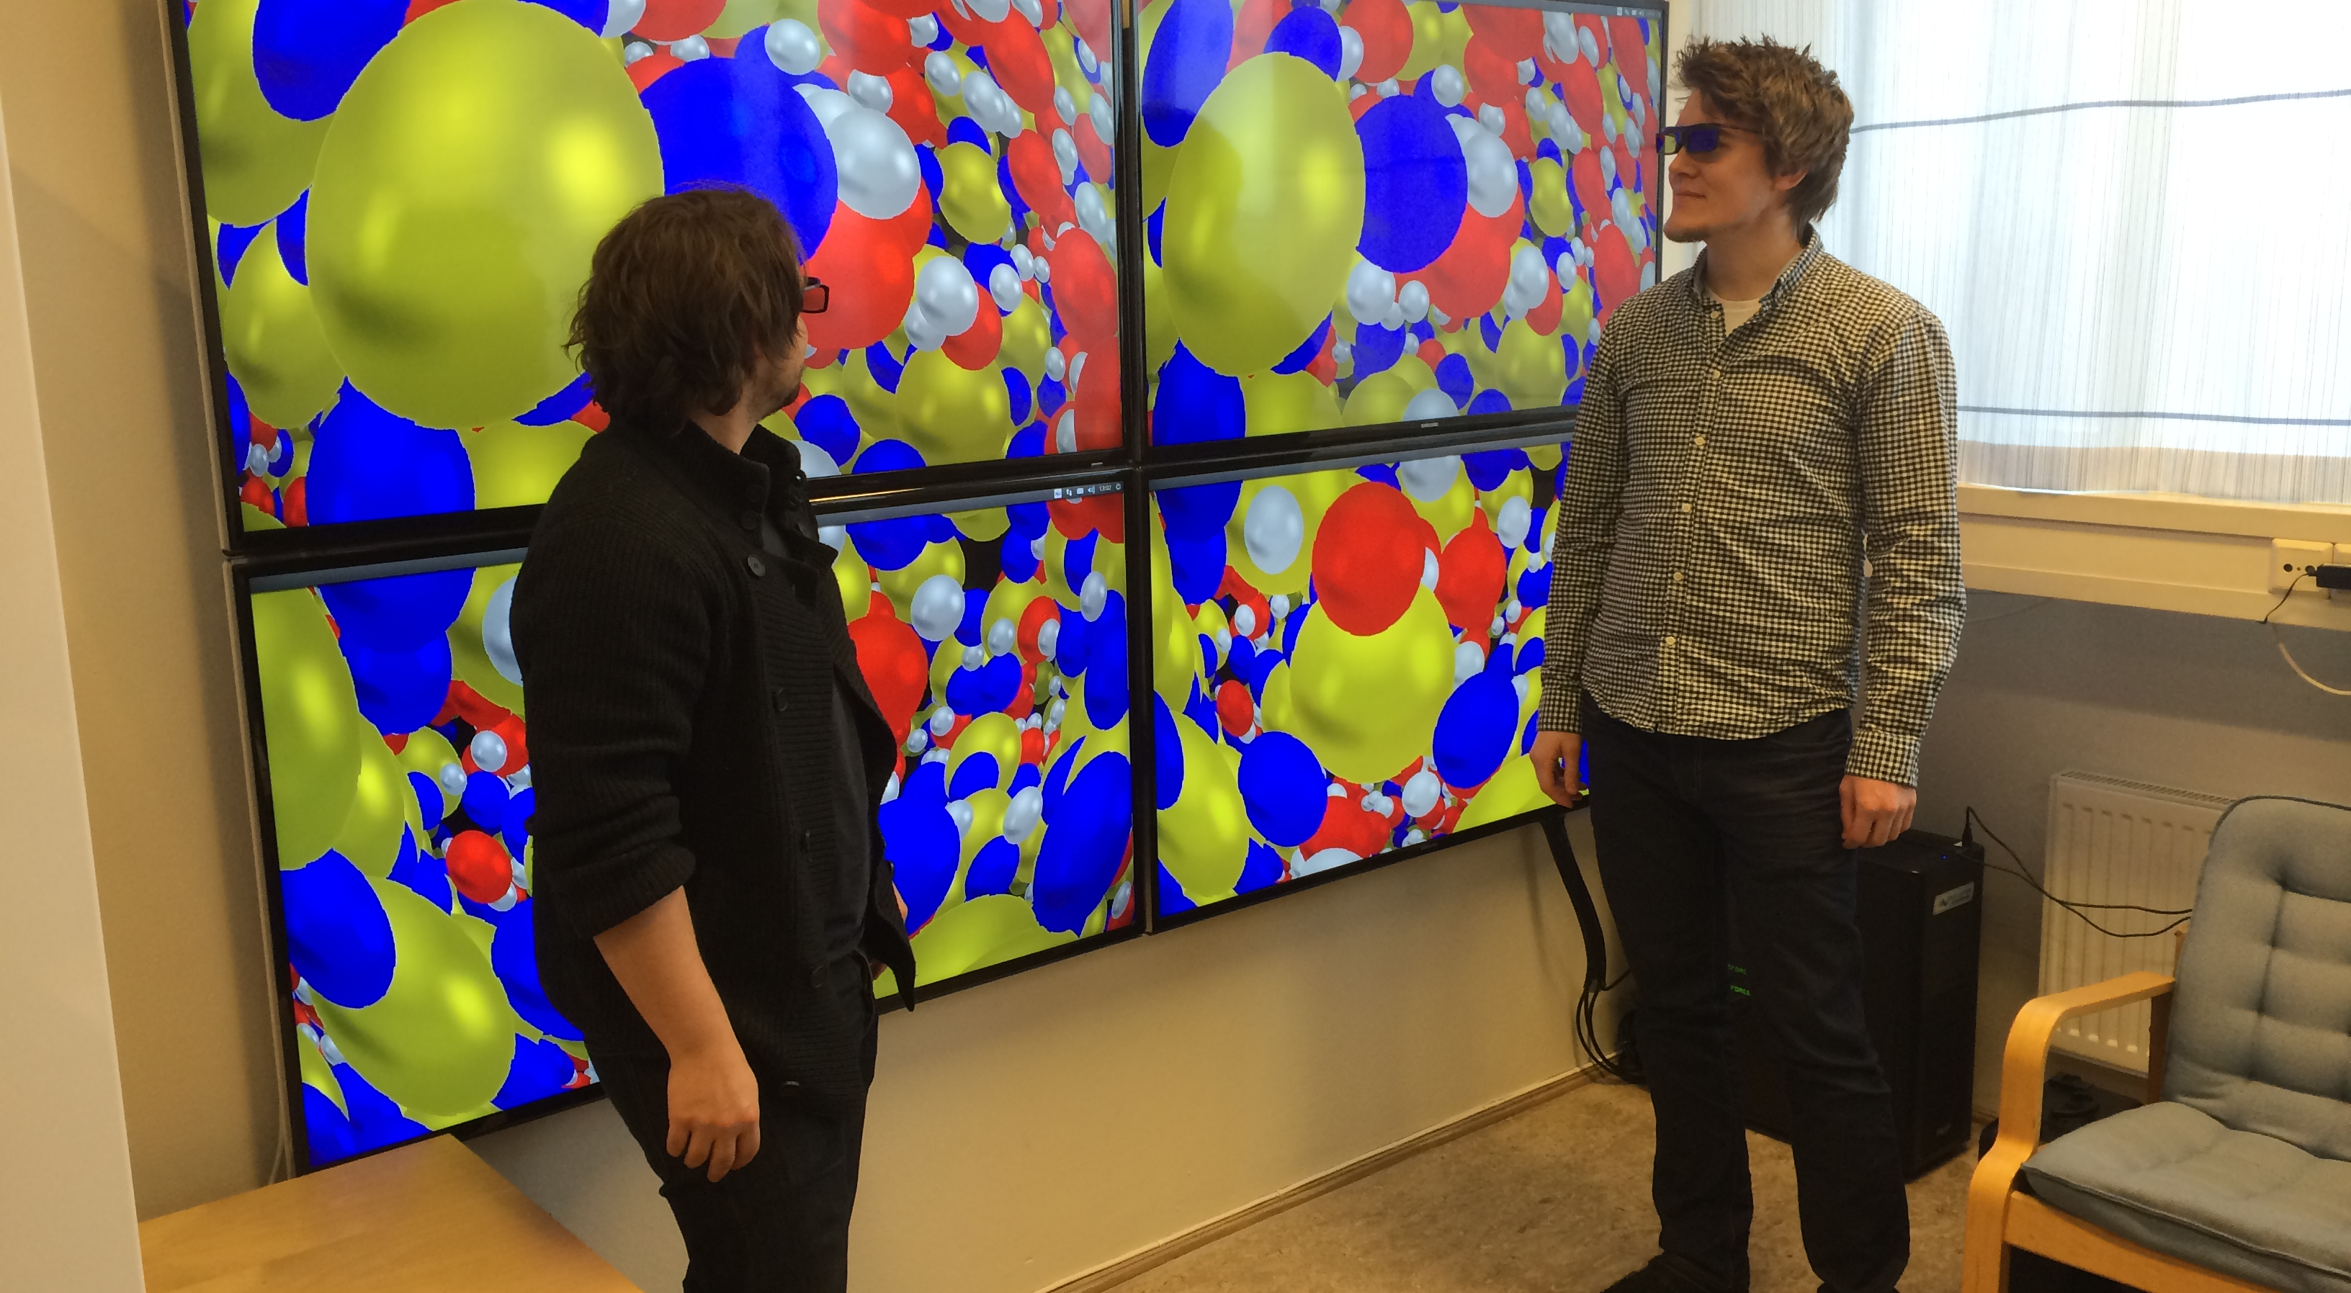
Investing in equipment for research and education

Slide 14
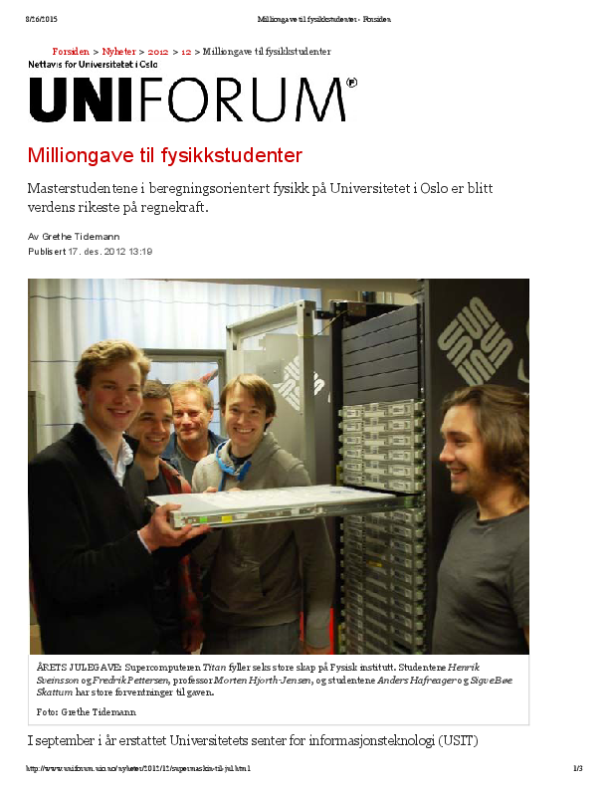
Building a local supercomputing cluster When UiO’s previous supercomputing cluster (titan.uio.no) was replaced by abel.uio.no, we got 200 nodes for free from USIT and built our own supercomputer

Slide 15
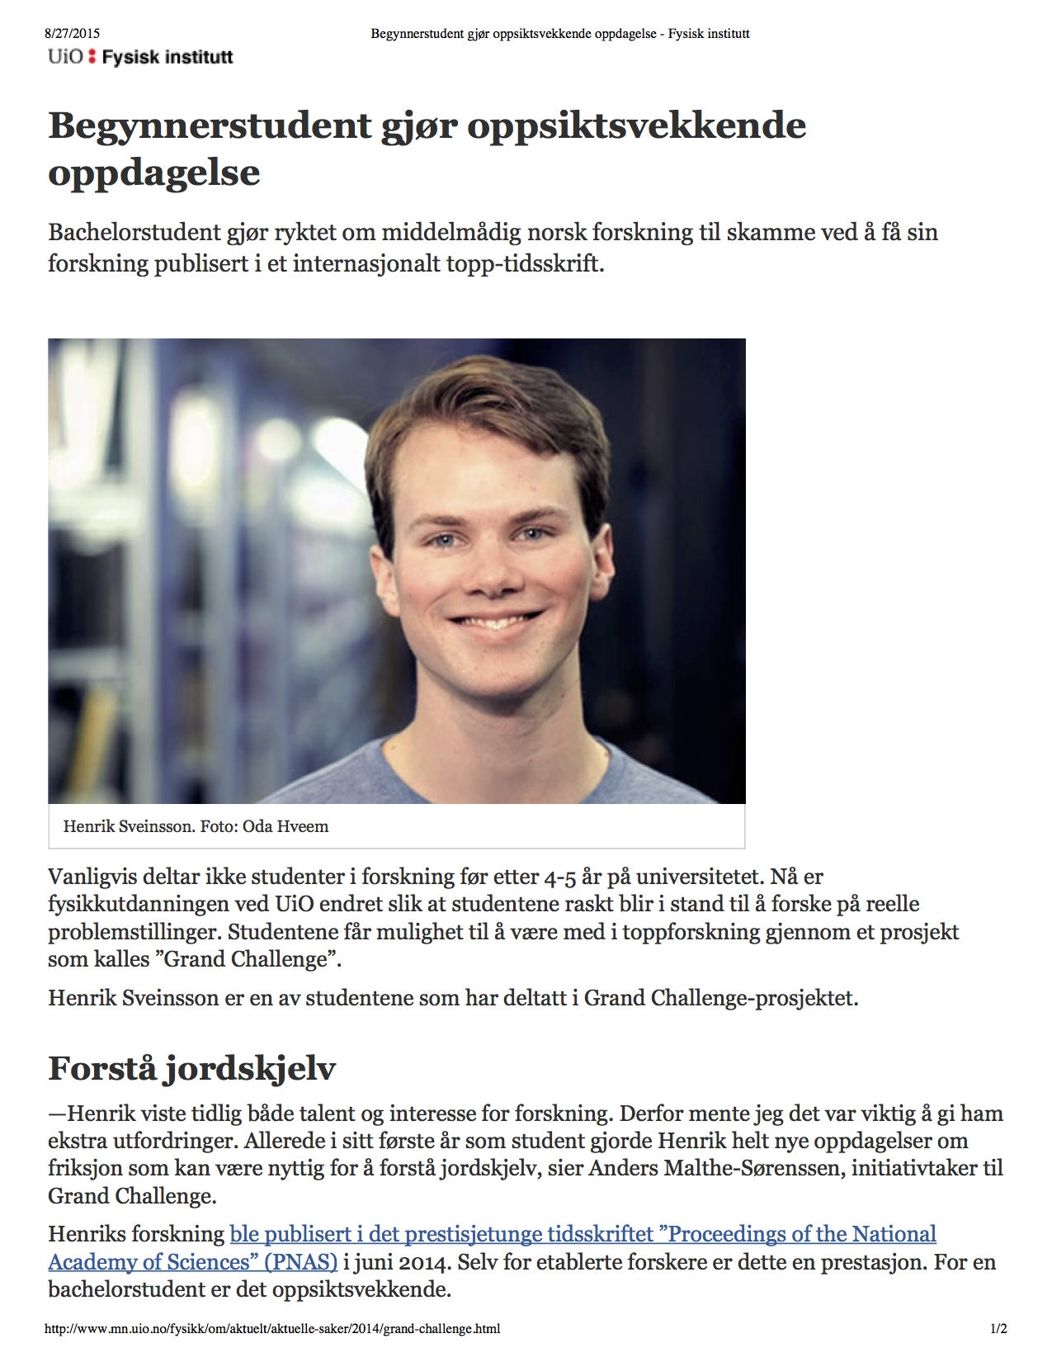
Undergraduate student publishes in PNAS Participating in research from day one! Bachelor and master students publish in scientific journals Students are exposed to all stages of the scientific process

Slide 16

The computational revolution in science and society
Computing will affect all aspects of society - and should also play a key role in research and education in our society
Possible large shifts with the advent of automation
Present and future problems involve complex systems
Require a multi-disciplinary approach
Collaboration and team work using computational tools
To stay competitive as a society we need computing competence integrated in all fields – for both research and education!
We need candidates with the right multi-disciplinary background and skills in computational thinking

Slide 17
UiO has a unique chance to become a Leading European University
UiO‘s strength in computational science (education and research) has the potential to make UiO a top European university
We must educate the competence needed
We are in a unique position to do so – across all fields!
How to achieve this:
Establish a new cross-disciplinary center/department with focus on computational science and its applications to a wide range of fields (science, medicine, humanities, social science, etc)
Hire ten young professors (age < 40) dedicated to innovative computational research and education
Establish another ten cross-departmental professorships
Establish best practice for computational and educational innovations, with particular focus on new learning material – and real incentives

Slide 18
Summary
Computing plays and will play an even more important role in society – and this must be reflected in research and education
Our program builds on this and allows students to realize their potential and unleash their creativity
Social and scientific activities in harmony
UiO is in a unique position to develop a leading research and educational activity – if we act now

Slide 19
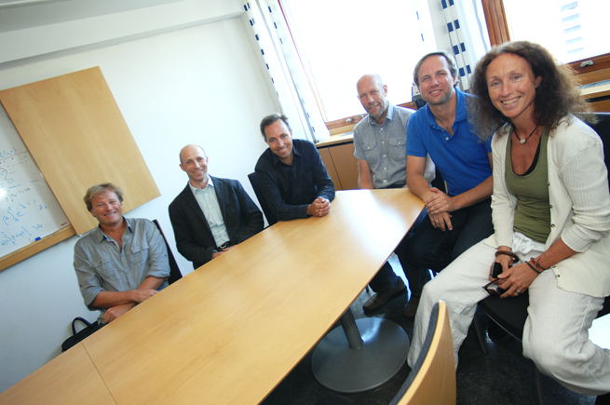
Computational Physics and the Computing in Science Education project
The results, ideas and thoughts presented here would have been impossible without the infinitely many interactions with colleagues in the Computing in Science Education project and all our fantastic students! Thank you!
Hans Petter Langtangen
Knut Mørken
Arnt Inge Vistnes
Øyvind Ryan
Solveig Kristensen and Annik Myhre
Hanne Sølna

